Slide 1



ניהול תקציב ואימון פיננסי
ניהול תקציב אישי ואימון משתמשים לשליטה פיננסית טובה יותר
האפליקציה מאפשרת למשתמשים לחשב בצורה פשוטה וברורה את ההכנסה החודשית הממוצעת שלהם, לעקוב באופן מסודר אחרי הוצאות והכנסות, ולקבל המלצות מעשיות להקטנת ההוצאות החודשיות.
חברי הקבוצה: מונדר אבראהים נור שאמא סלים יוסף

Slide 2



ניהול תקציב אישי ואימון משתמשים לשליטה פיננסית טובה יותר
Number | Name | Description
1 | Home Page | General site info, signup and login buttons
2 | Signup | New user registration form
3 | Login | User login form
4 | Income Entry | User inputs last five months' incomes
5 | Dashboard | Display monthly average income, transactions, and statistics
6 | Add Transaction | Form to add new transactions
7 | Stats & Suggestions | Monthly expense statistics and spending suggestions
8 | Discipline Training | Screen with financial tips & habit training
האפליקציה מאפשרת למשתמשים לחשב בצורה פשוטה וברורה את ההכנסה החודשית הממוצעת שלהם, לעקוב באופן מסודר אחרי הוצאות והכנסות, ולקבל המלצות מעשיות להקטנת ההוצאות החודשיות.
ניהול תקציב ואימון פיננסי
חברי הקבוצה: מונדר אבראהים נור שאמא

Slide 3
Scenario | Description
Signup | User registers a new account
Login | User logs in with existing credentials
Income Calculation | User enters incomes, app calculates monthly average
Add Transactions | User adds expenses into the system
Monthly Report Generation | App generates monthly spending stats & improvement suggestions
Discipline Training | User receives financial advice, habit management techniques
# | Name | Description
1 | Home Page | General site info, signup and login buttons
2 | Signup | New user registration form
3 | Login | User login form
4 | Dashboard | Display monthly average income, transactions and statistics
5 | Add Transaction | Form to add new transactions
6 | AI Suggestions | screen with financial tips and spending suggestions.
7 | Settings | Profile management and password updates

Slide 4
Table Name | Fields
Users | userId(PK) , name , email(UN) , phone , averageIncome
Transitions | transactionId(PK) , userId(FK) , name , description , date , amount
Scenario | Description
Signup | User registers a new account
Income Calculation | User enters incomes, app calculates monthly average
Login | User logs in with existing credentials
Add Transactions | User adds expenses into the system
Monthly Report Generation | App generates monthly spending stats & improvement suggestions
AI Recommendations | User receives financial advice, habit management techniques
Number | Name | Description
1 | Home Page | General site info, signup and login buttons
2 | Signup | New user registration form
3 | Login | User login form
4 | Income Entry | User inputs last five months' incomes
5 | Dashboard | Display monthly average income, transactions, and statistics
6 | Add Transaction | Form to add new transactions
7 | Stats & Suggestions | Monthly expense statistics and spending suggestions
8 | Discipline Training | Screen with financial tips & habit training

Slide 5
Table Name | Fields
Users | user_id(PK) , name , email(UN) , password , phone
Transaction | transaction_id(PK) , user_id(FK) , description , date , amount, category, is_recurring, recurring_duration
Statistics | stats_id, user_id(FK), avg_monthly_income, total_savings, last_updated
Scenario | Description
Signup | User registers a new account
Login | User logs in with existing credentials
Income Calculation | User enters incomes, app calculates monthly average
Add Transactions | User adds expenses into the system
Monthly Report Generation | App generates monthly spending stats & improvement suggestions
Discipline Training | User receives financial advice, habit management techniques

Slide 6
Object Name | Name | Description
User | Represents a registered user account | User ID Email Password Name Phone Number
Transaction | Records financial entries (income/expenses) | Transaction ID Amount (+/-) Category Date Recurrence Setting Description
Dashboard Summary | Financial Overview | Current Balance Monthly Income Monthly Expenses Top Spending Categories

Slide 7
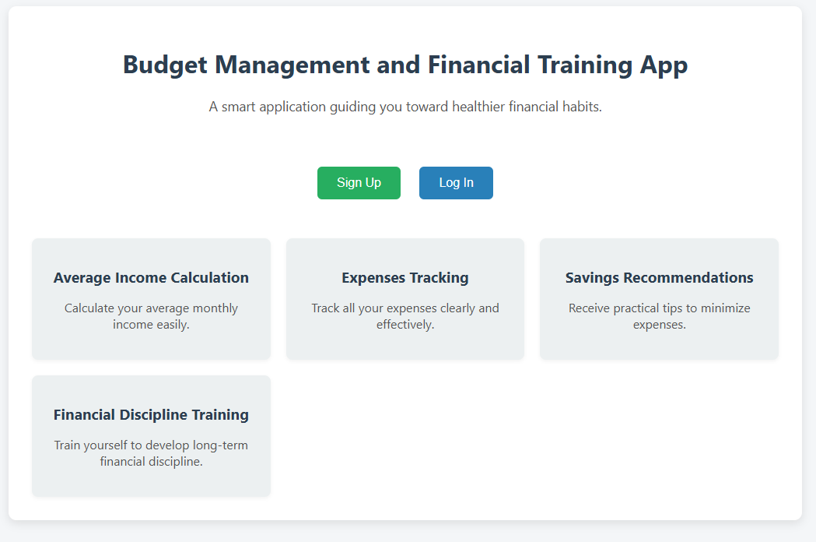
Click To View Website

